Slide 1

SPRINT 1
Team Members
Latha Jerripothula
Likitha Macharla
Madhunika Reddy
Mailapalli Jayasri Amulya
Thandava Krishna Parasaram
GROUP 4

Slide 2

contents
About the Project
Role of testers in each Module
Process of Testing
Epics and User Stories
Test Scenarios
Requirements
Test Cases
Defect Reporting
Traceability Matrix
Summary Report
Challenges faced and overcome

Slide 3
About the project
The main purpose of this Bookmyshow Project that theatres have been serving since their inception is to provide the tickets for the audience for the specified movie of specified show.
Traditionally the theatres will be on rush which wastes the time of the common man
The Main Modules Tested by Online Movie Ticket Booking System are
Verify Sign In Functionality
Verify Location Functionality
Verify Book Theatre Functionality
Verify Search Movie Functionality
Verify Booking Seats Functionality
Verify Booking Summary Before Payment Functionality

Slide 4
Role of testers in each module
TESTER
All
Jayasri Amulya
Latha Jerripothula
Madhunika Reddy
Likitha Macharla
Thandava Krishna
MODULE
Sign In Functionality
Location Functionality
Book Theatre Functionality
Search Movie Functionality
Booking Seats Functionality
Booking Summary Before Payment Functionality

Slide 5
Process of Testing
Writing Epics and User Stories
Writing Test Scenarios
Writing Test cases and Requirements
Executing Test cases in Jira Softwares
Writing Defect Reporting
Writing Traceability Matrix
Writing Summary Report

Slide 6
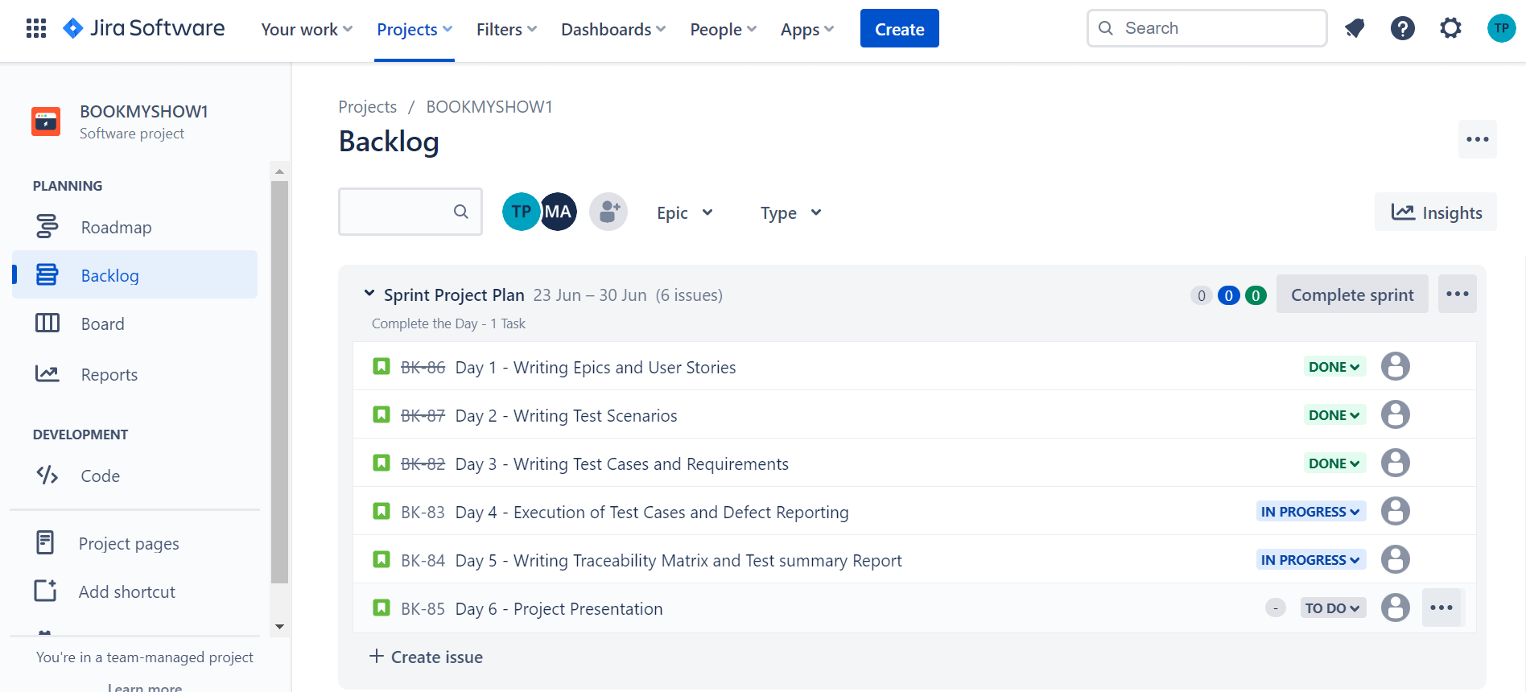
Sprint Plan

Slide 7
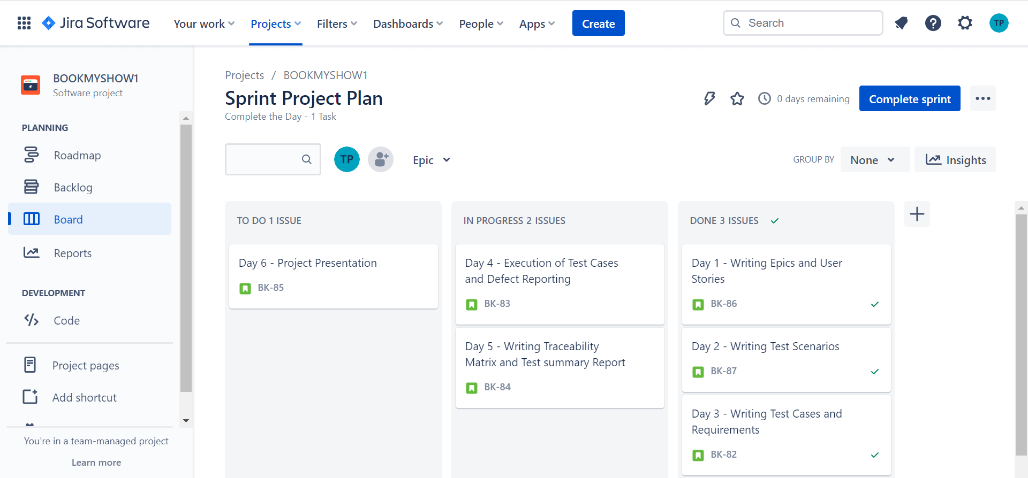

Slide 8
High Level Epics And User Stories
Epic :
An epic is a large chunk of work that you cannot deliver during one sprint.
Instead you can break it down into smaller, more specific units called User stories.
User Stories:
User stories are the smallest units of work in an agile framework.
Several similar user stories makeup an epic.

Slide 9
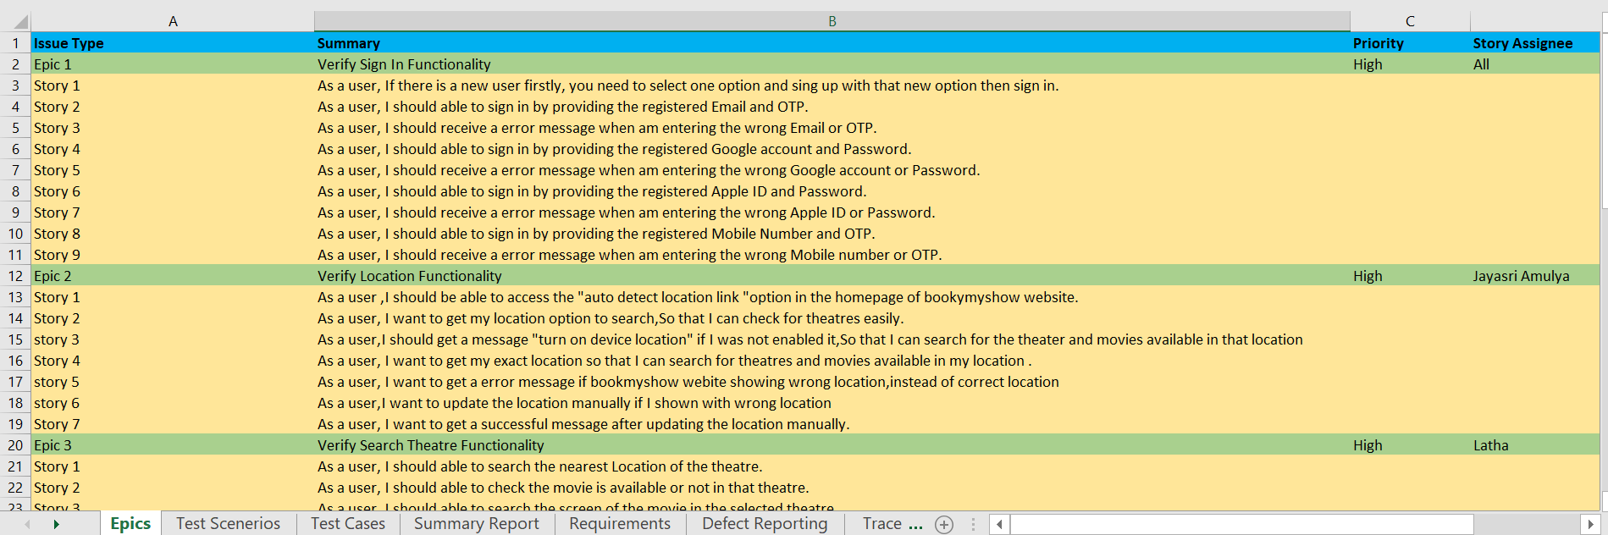
These are the Some of Epics and User stories taken in this bookmyshow website.

Slide 10
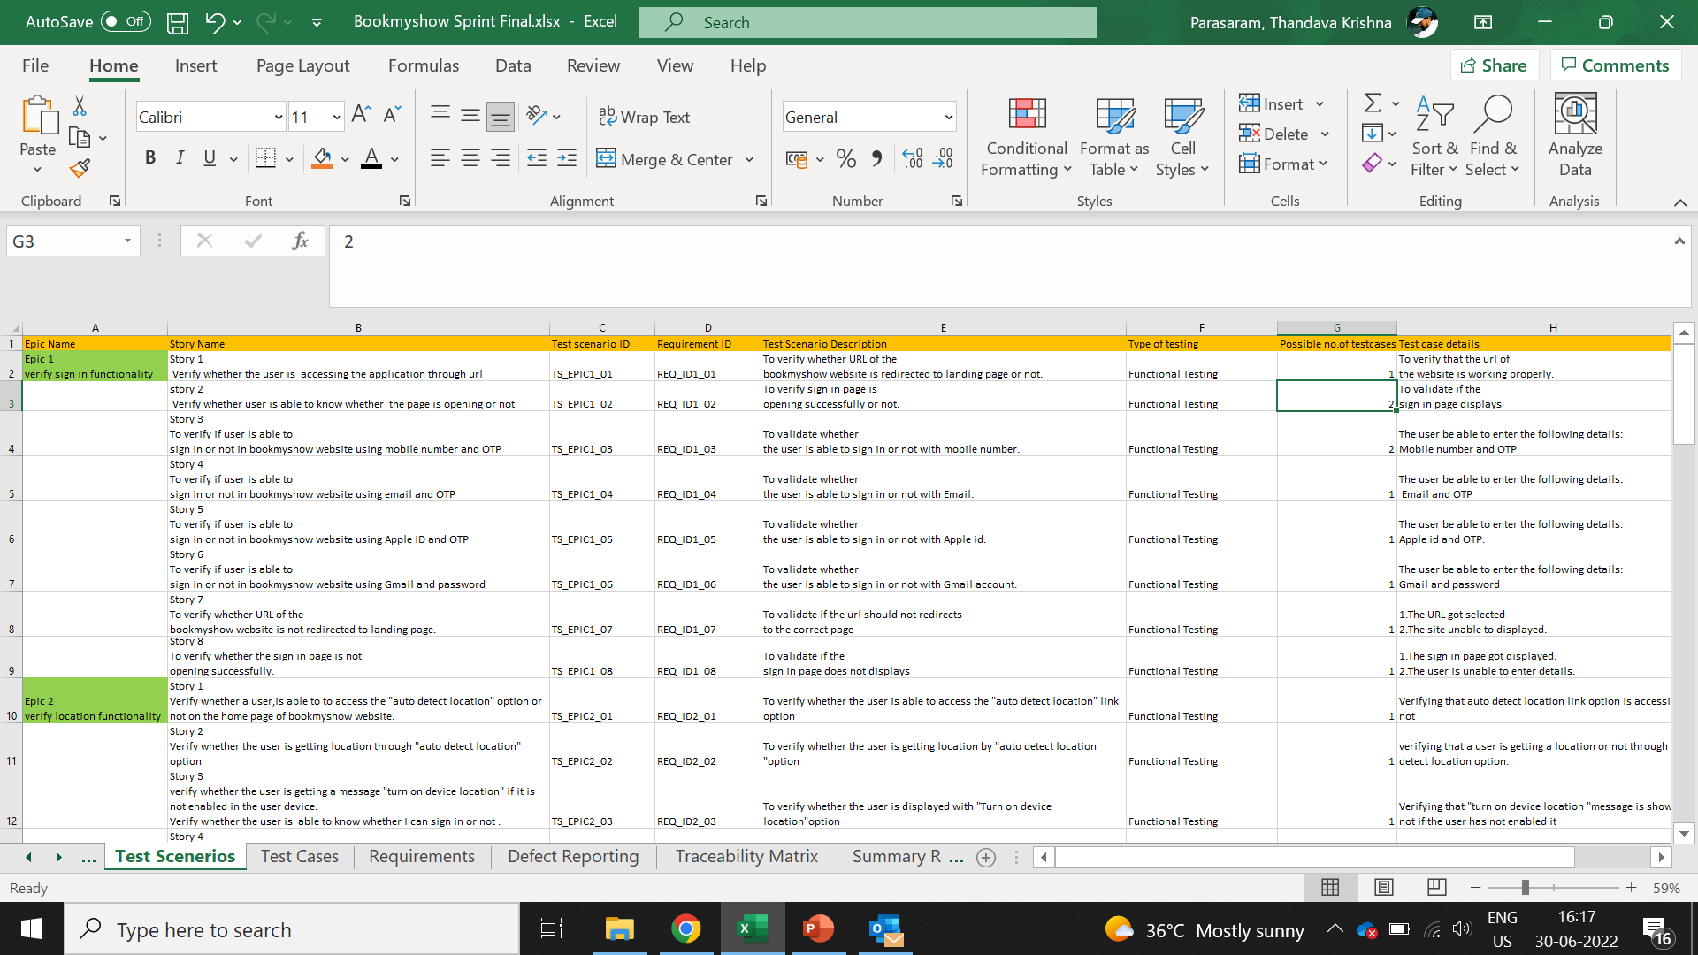
Test Scenarios

Slide 11
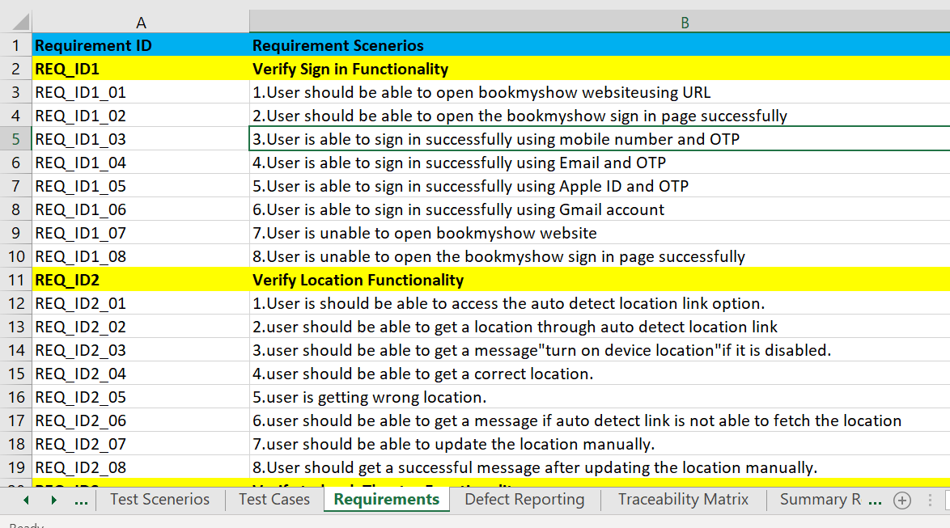
Requirements

Slide 12
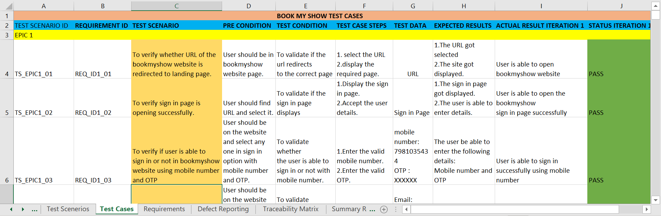
Test Cases

Slide 13
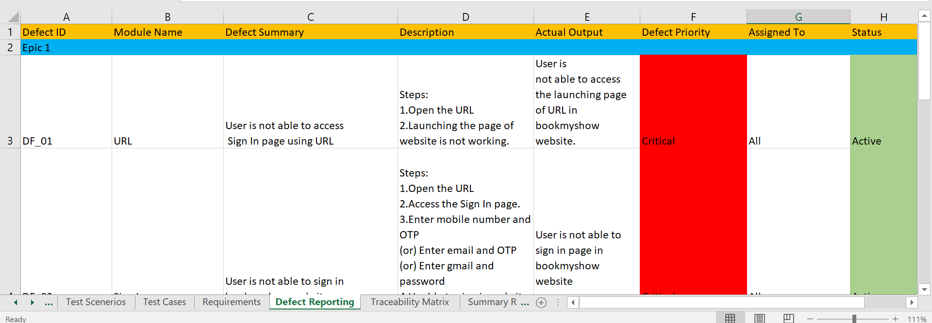
Defect Reporting

Slide 14
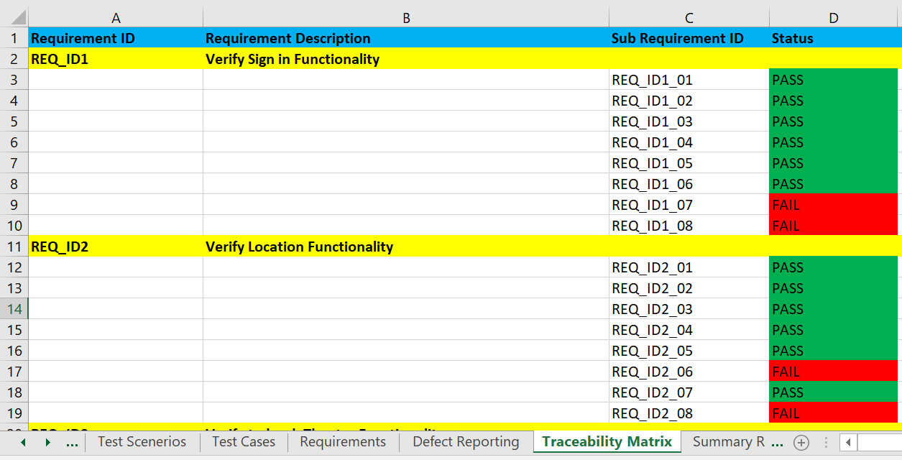
Traceability Matrix

Slide 15
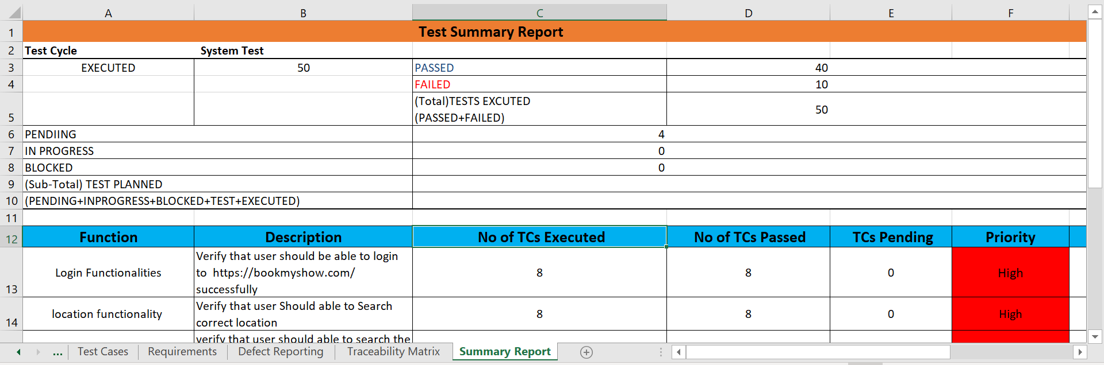
Summary Report

Slide 16
Challenges Faced
In bookmyshow project we faced issues like some times website are not worked when we launch.
As this is Functional testing we does not faced more issue and live application has some of errors in rare case.
How Did We Overcome
We overcome this issues using functional testing and check whether there is any issues in bookmyshow website.

Slide 17




Thank you
SPRINT 1 PROJECT

